Slide 1
A neural basis of probabilistic computation in visual cortex
周丽琴
2022/3/25

Slide 2
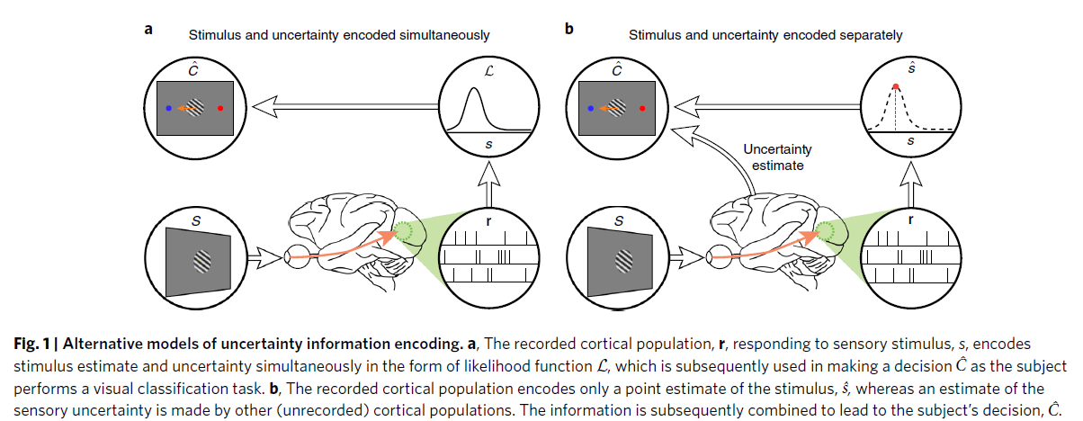
研究目的：利用贝叶斯方法和DNN等计算模型探究不确定性编码的脑科学证据。
核心问题：探索编码某个状态的脑区是否也编码该状态的不确定性。
大脑是否会在决策中使用这一不确定性信息。

Slide 3
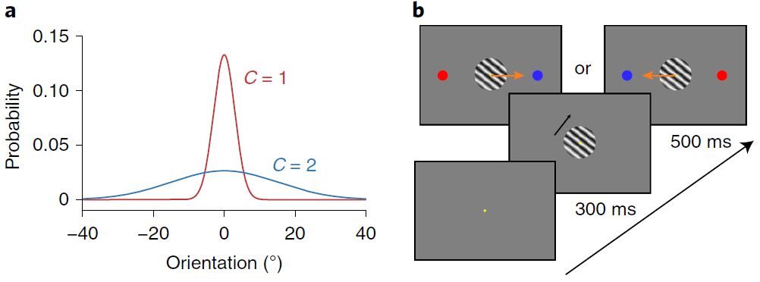
猕猴实验任务：朝向分类任务
两类光栅的朝向均服从高斯分布且均值相同，但标准差(即：不确定性)不同。

Slide 4
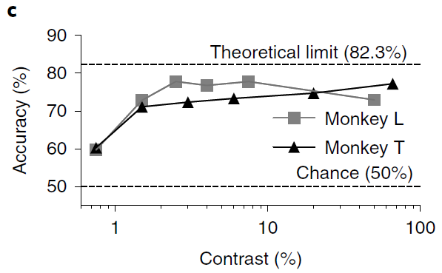
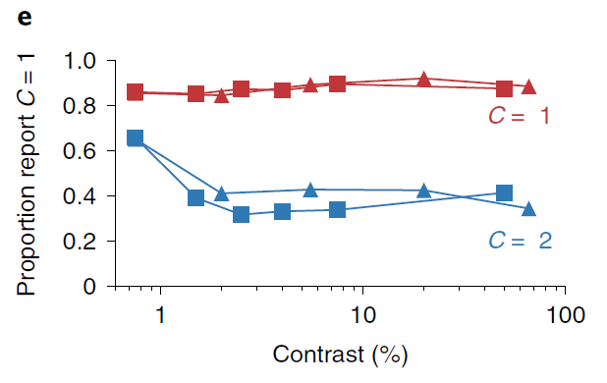
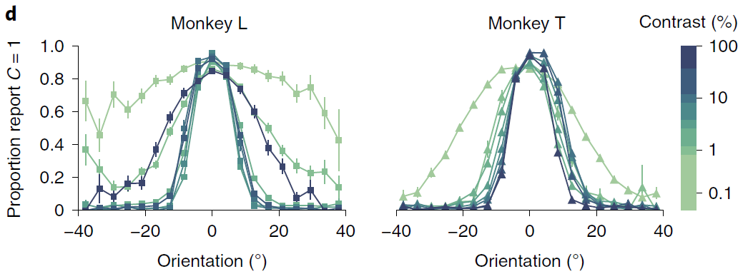
猕猴行为表现：
猕猴的心理测量曲线表明其分类表现同时受对比度和朝向影响。

Slide 5
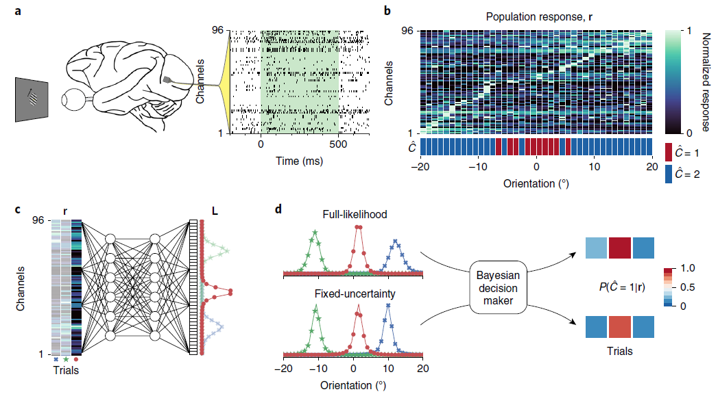
模型构建：
眼跳出现之前的500ms刺激呈现阶段。
Full-likelihood decoder
Decision models

Slide 6
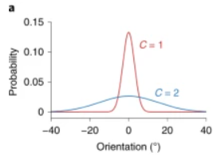







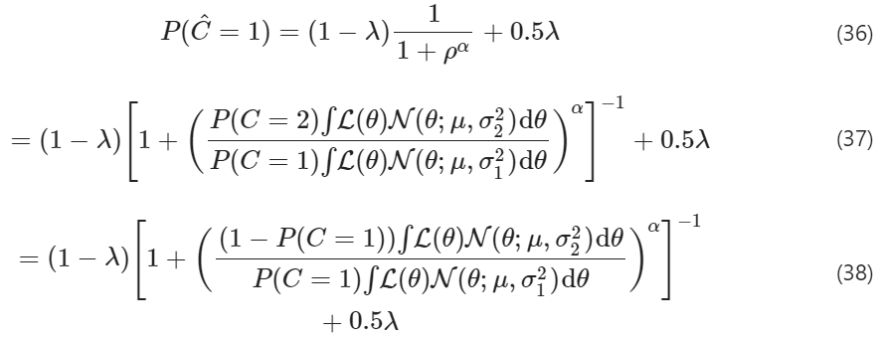


目标：
,
P(r|C=2)
Decoder：似然
Decision model:
最大后验估计
The model parameters were fitted by maximizing the total log likelihood over all trials (indexed by i) for each contrast-session,

Slide 7
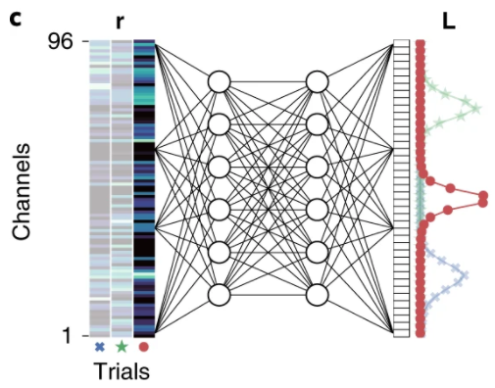

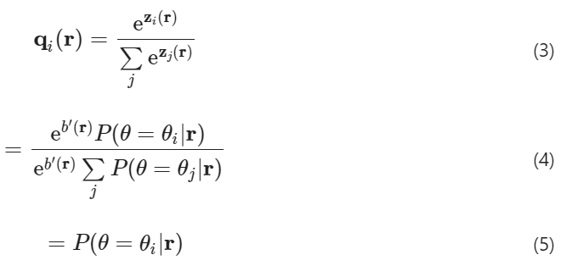
Full-likelihood decoder
Let us assume that m multiunits were recorded simultaneously in a single recording session, so that r ∈ ℝ^{m}.
The likelihood function can be captured by a vector L ∈ ℝ^{n}, where L_{i}=L(θ_{i}).
目标：
θ的后验函数：
θ的后验函数：

Slide 8
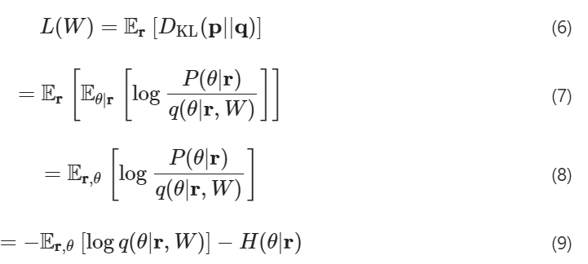
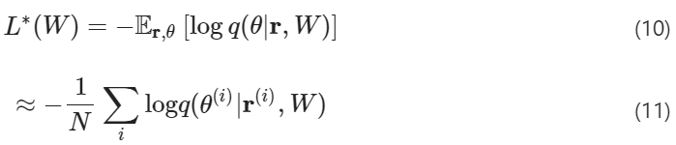

Decorder的优化：KL散度
损失函数：
未知但相对W固定。
惩罚项：

Slide 9
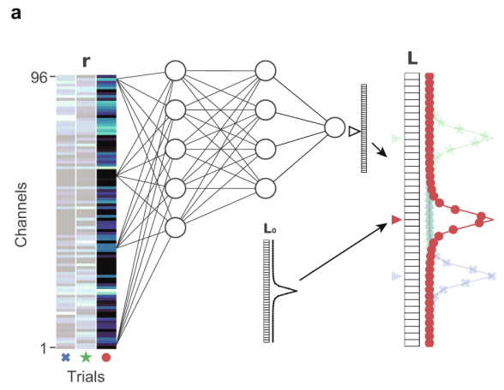
Full-likelihood decoder
Fixed-uncertainty decoder
The fixed-uncertainty model captures the alternative hypothesis in which the recorded sensory population encodes only a point estimate of the sensory variable (that is, mean of the likelihood function) and the estimate of the sensory uncertainty is encoded elsewhere.

Slide 10

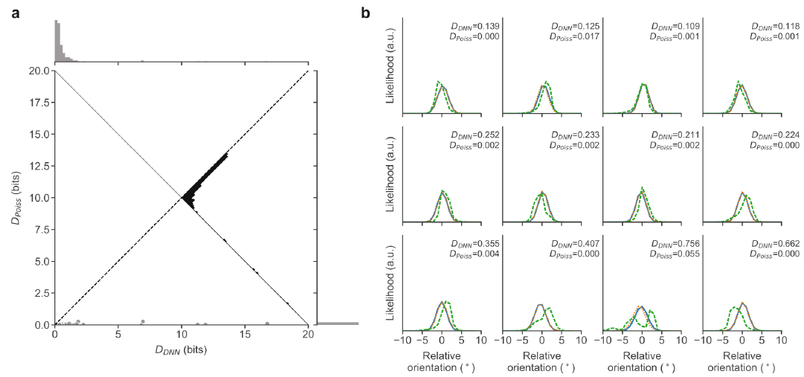
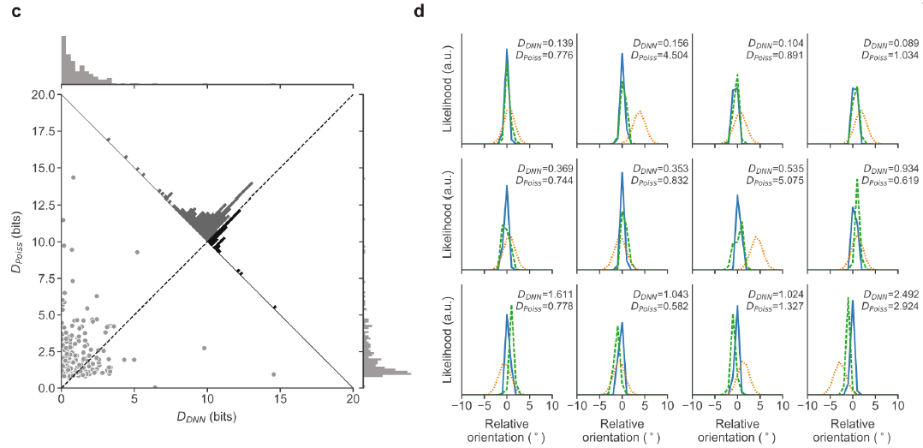
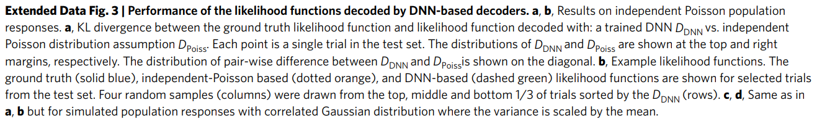
各类解码器解码的似然函数的表现：
DNN can closely approximate the ground-truth likelihood function from simulated responses sampled from known distributions.
Independent Poisson population responses
Correlated Gaussian population responses

Slide 11
Why use DL to decode the trial-by-trial likelihood function?
Although the simplifying assumption makes computing the trial-by-trial likelihood function straightforward, disregarding potential correlations among the units in population responses (that is, noise correlations and internal brain state fluctuations) can lead to biased estimates of the likelihood function and limit the generality of this approach.

Slide 12
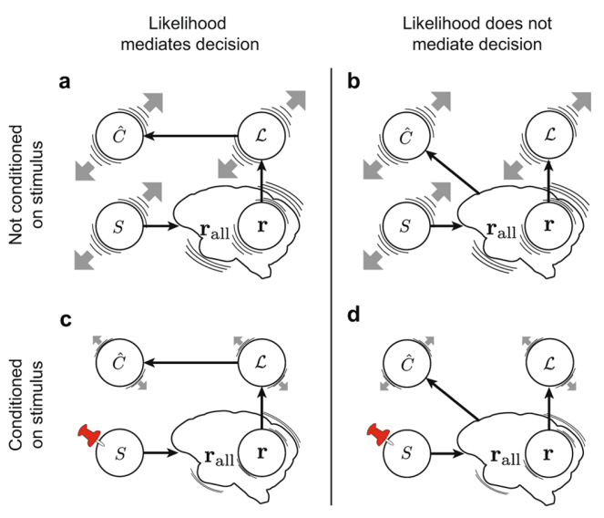
trial-to-trial的不确定性会改善对行为的预测性：
To illustrate the importance of conditioning on the stimulus to determine whether the decoded likelihood function mediates perceptual decisions, consider a typical perceptual decision-making task (like ours), where the subject views a stimulus, s, which elicits a population response, r, for example, in V1.
If the likelihood function truly mediates the decision, we expect that such variation in L would account for variation in Ĉ. Therefore, to demonstrate that the likelihood L mediates the decision Ĉ, it is imperative to show a correlation between L and Ĉ conditioned on the stimulus, s.

Slide 13
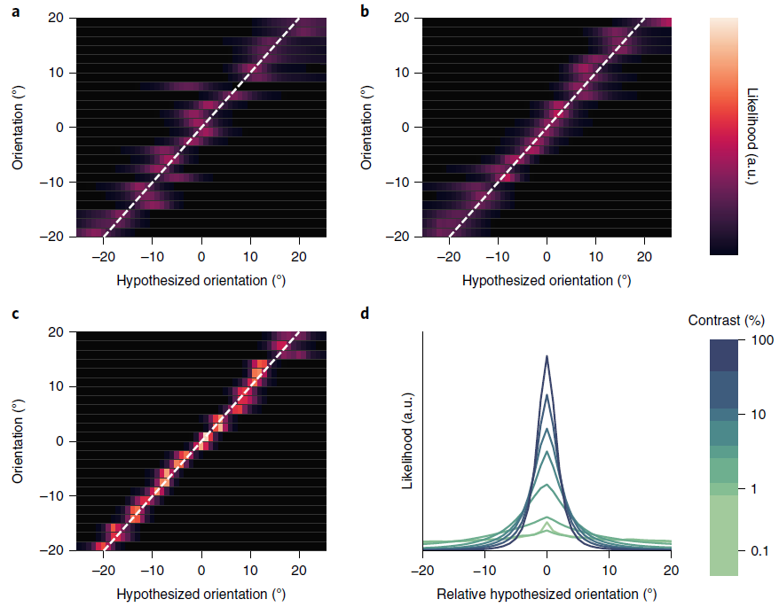
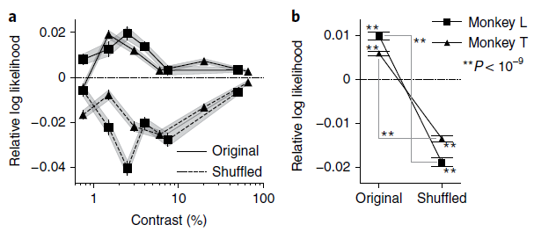
全似然解码器解码的似然函数形状携带了决策相关的知觉不确定性信息：
4% contrast
32% contrast
100% contrast
The trial log-likelihood difference between the full-likelihood and fixed-uncertainty models was significant for both monkeys.
This result shows that the trial-by-trial fluctuations in the shape of the likelihood function are informative about the monkey’s trial-by-trial decisions, demonstrating that decision-relevant sensory uncertainty information is contained in population responses that can be captured by the shape of the full likelihood function.
Likelihood functions decoded by the full-likelihood decoder exhibited the expected dependencies on the overt drivers of uncertainty such as contrast: the width of the likelihood function was higher at lower contrast.

Slide 14
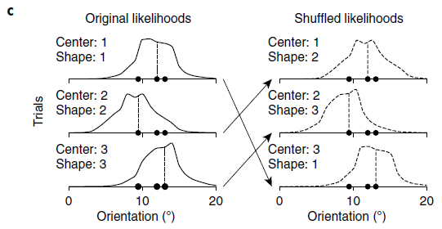
打乱似然函数的形状对模型的预测表现有影响：
The shuffling of the likelihood function shapes abolished the improvement in prediction performance that the full-likelihood model had over the fixed-uncertainty model.
The trial-by-trial likelihood function decoded from the population represents behaviorally relevant stimulus uncertainty information, even when conditioned on the stimulus.

Slide 15
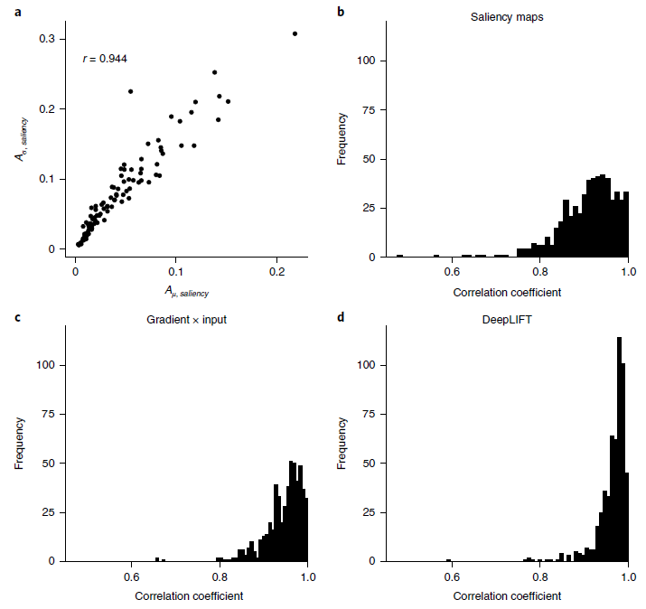
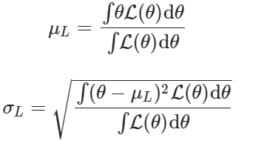


归因分析：
Across all contrast sessions from both monkeys, A_{μ} was strongly positively correlated with A_{σ} regardless of the exact attribution method used, suggesting that the highly overlapping subpopulations are involved in encoding both the point estimate and the uncertainty of the likelihood function, as we hypothesized would be the case.

Slide 16
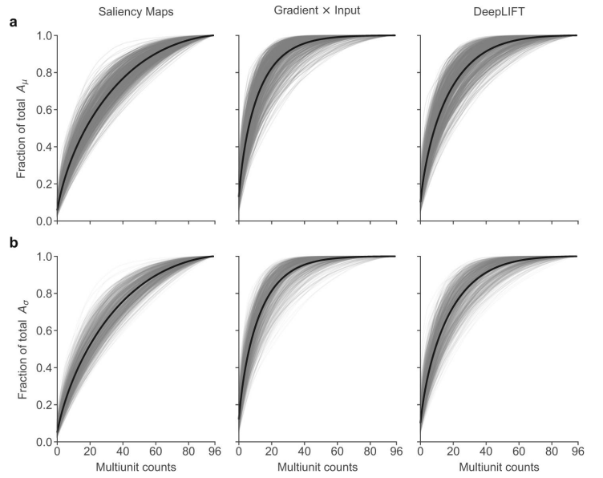

Slide 17
结论：
Using the trial-to-trial changes in the shape of the likelihood function allowed us to better predict the behavior than using a likelihood function with a fixed shape shifted by a point estimate.
In perceptual decision-making, the same cortical population that encodes a sensory variable also encodes its trial-by-trial sensory uncertainty information.

